Slide 1
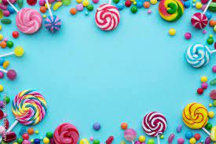
Sweet Teeth
By Sherlon, Stefan and Barkat

Slide 2
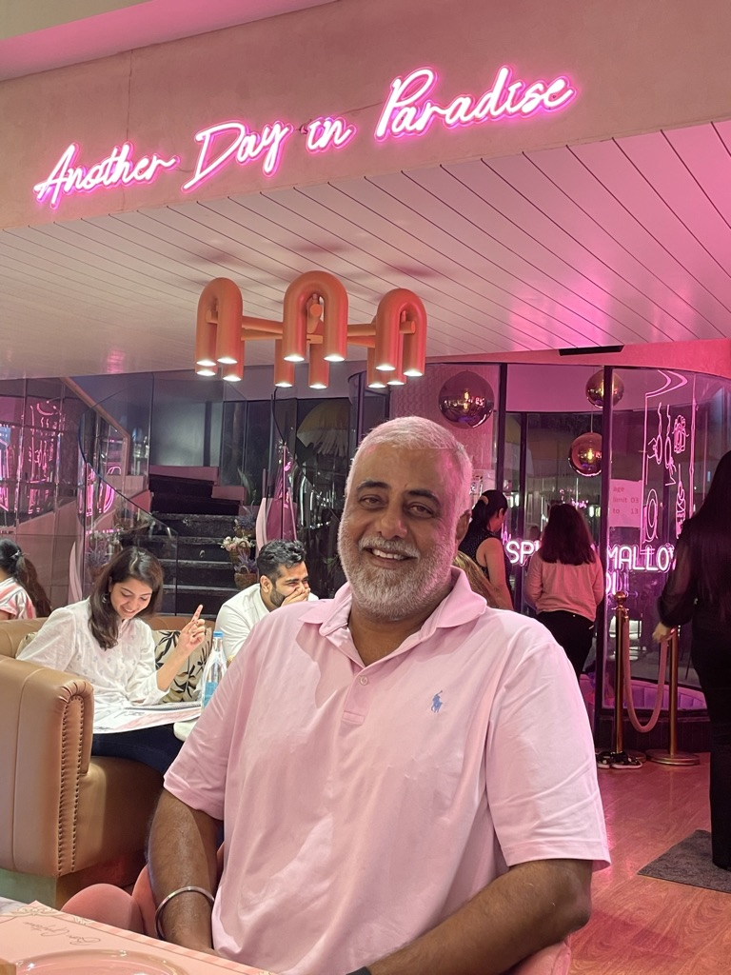
My father…
Sweet Teeth

Slide 3

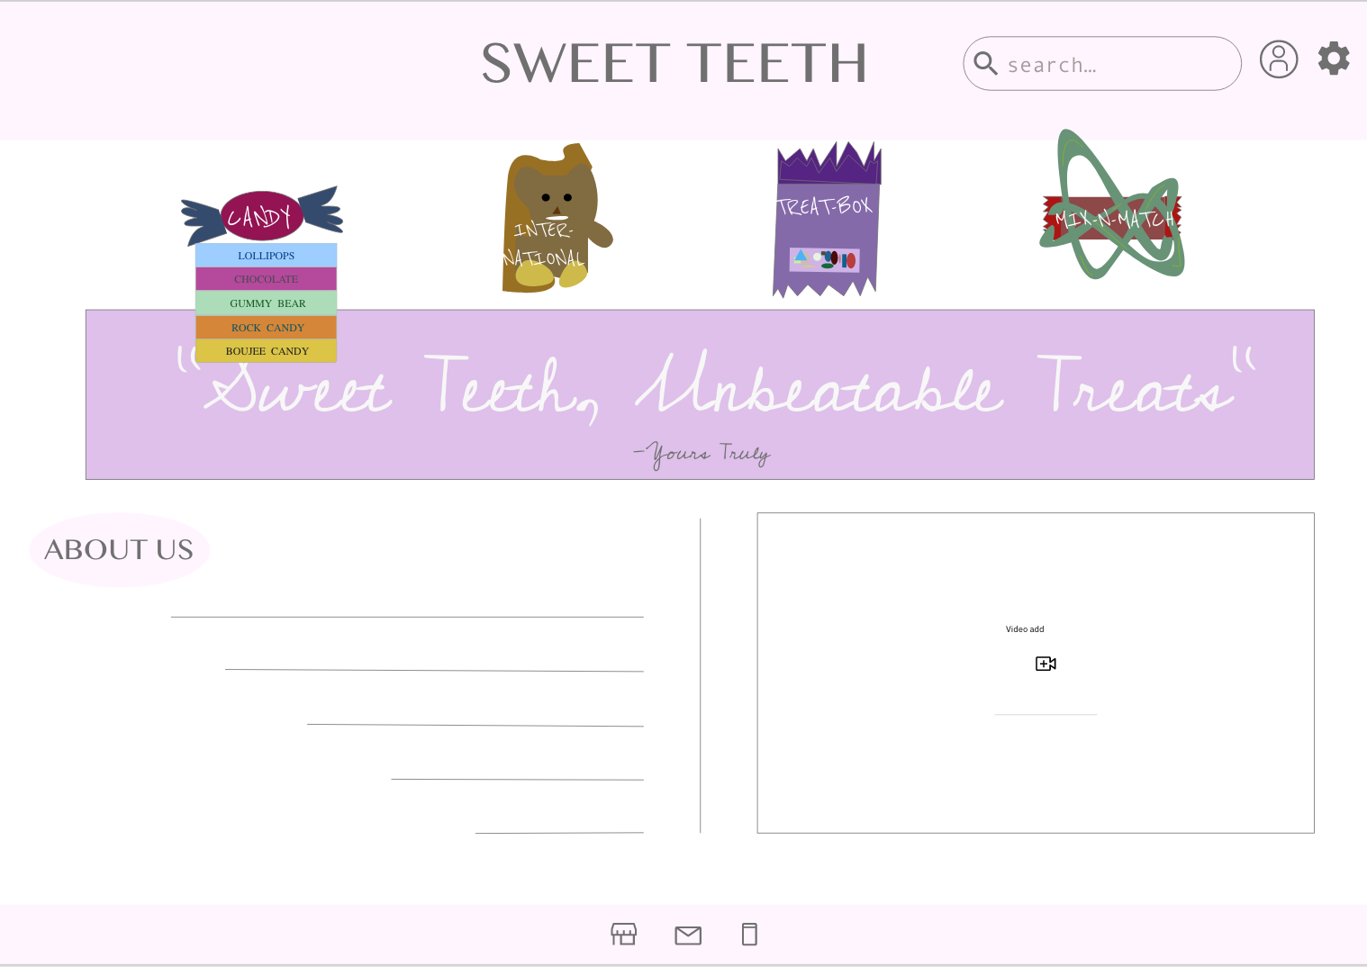
HOME PAGE

Slide 4
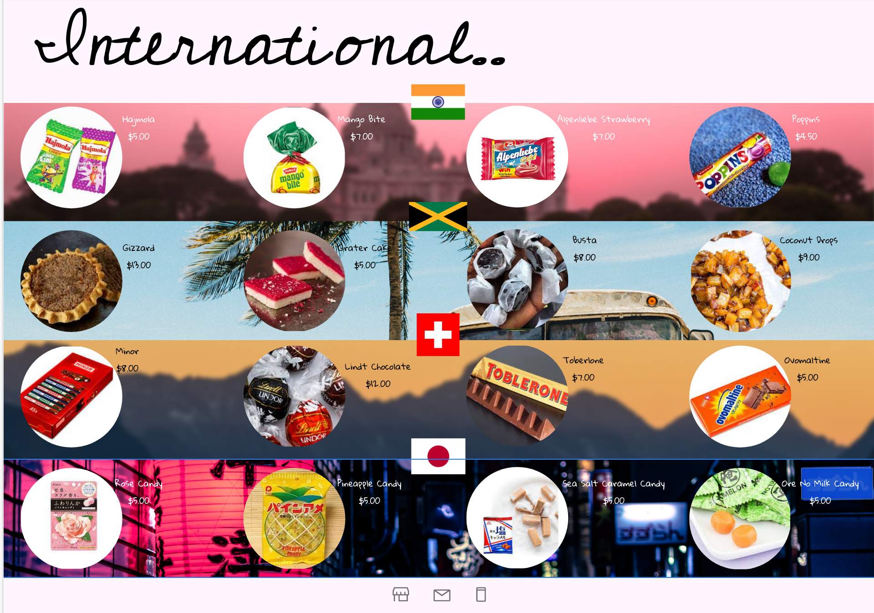
Treats From around the World

Slide 5
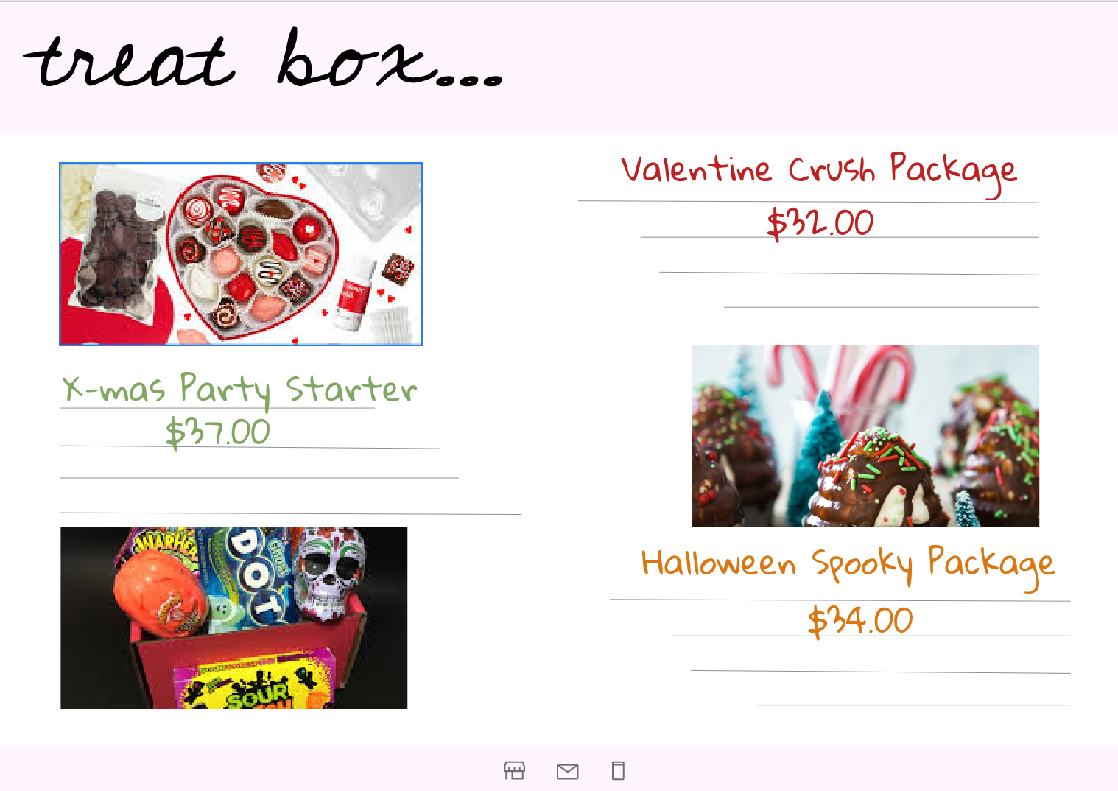
Themed Boxes

Slide 6
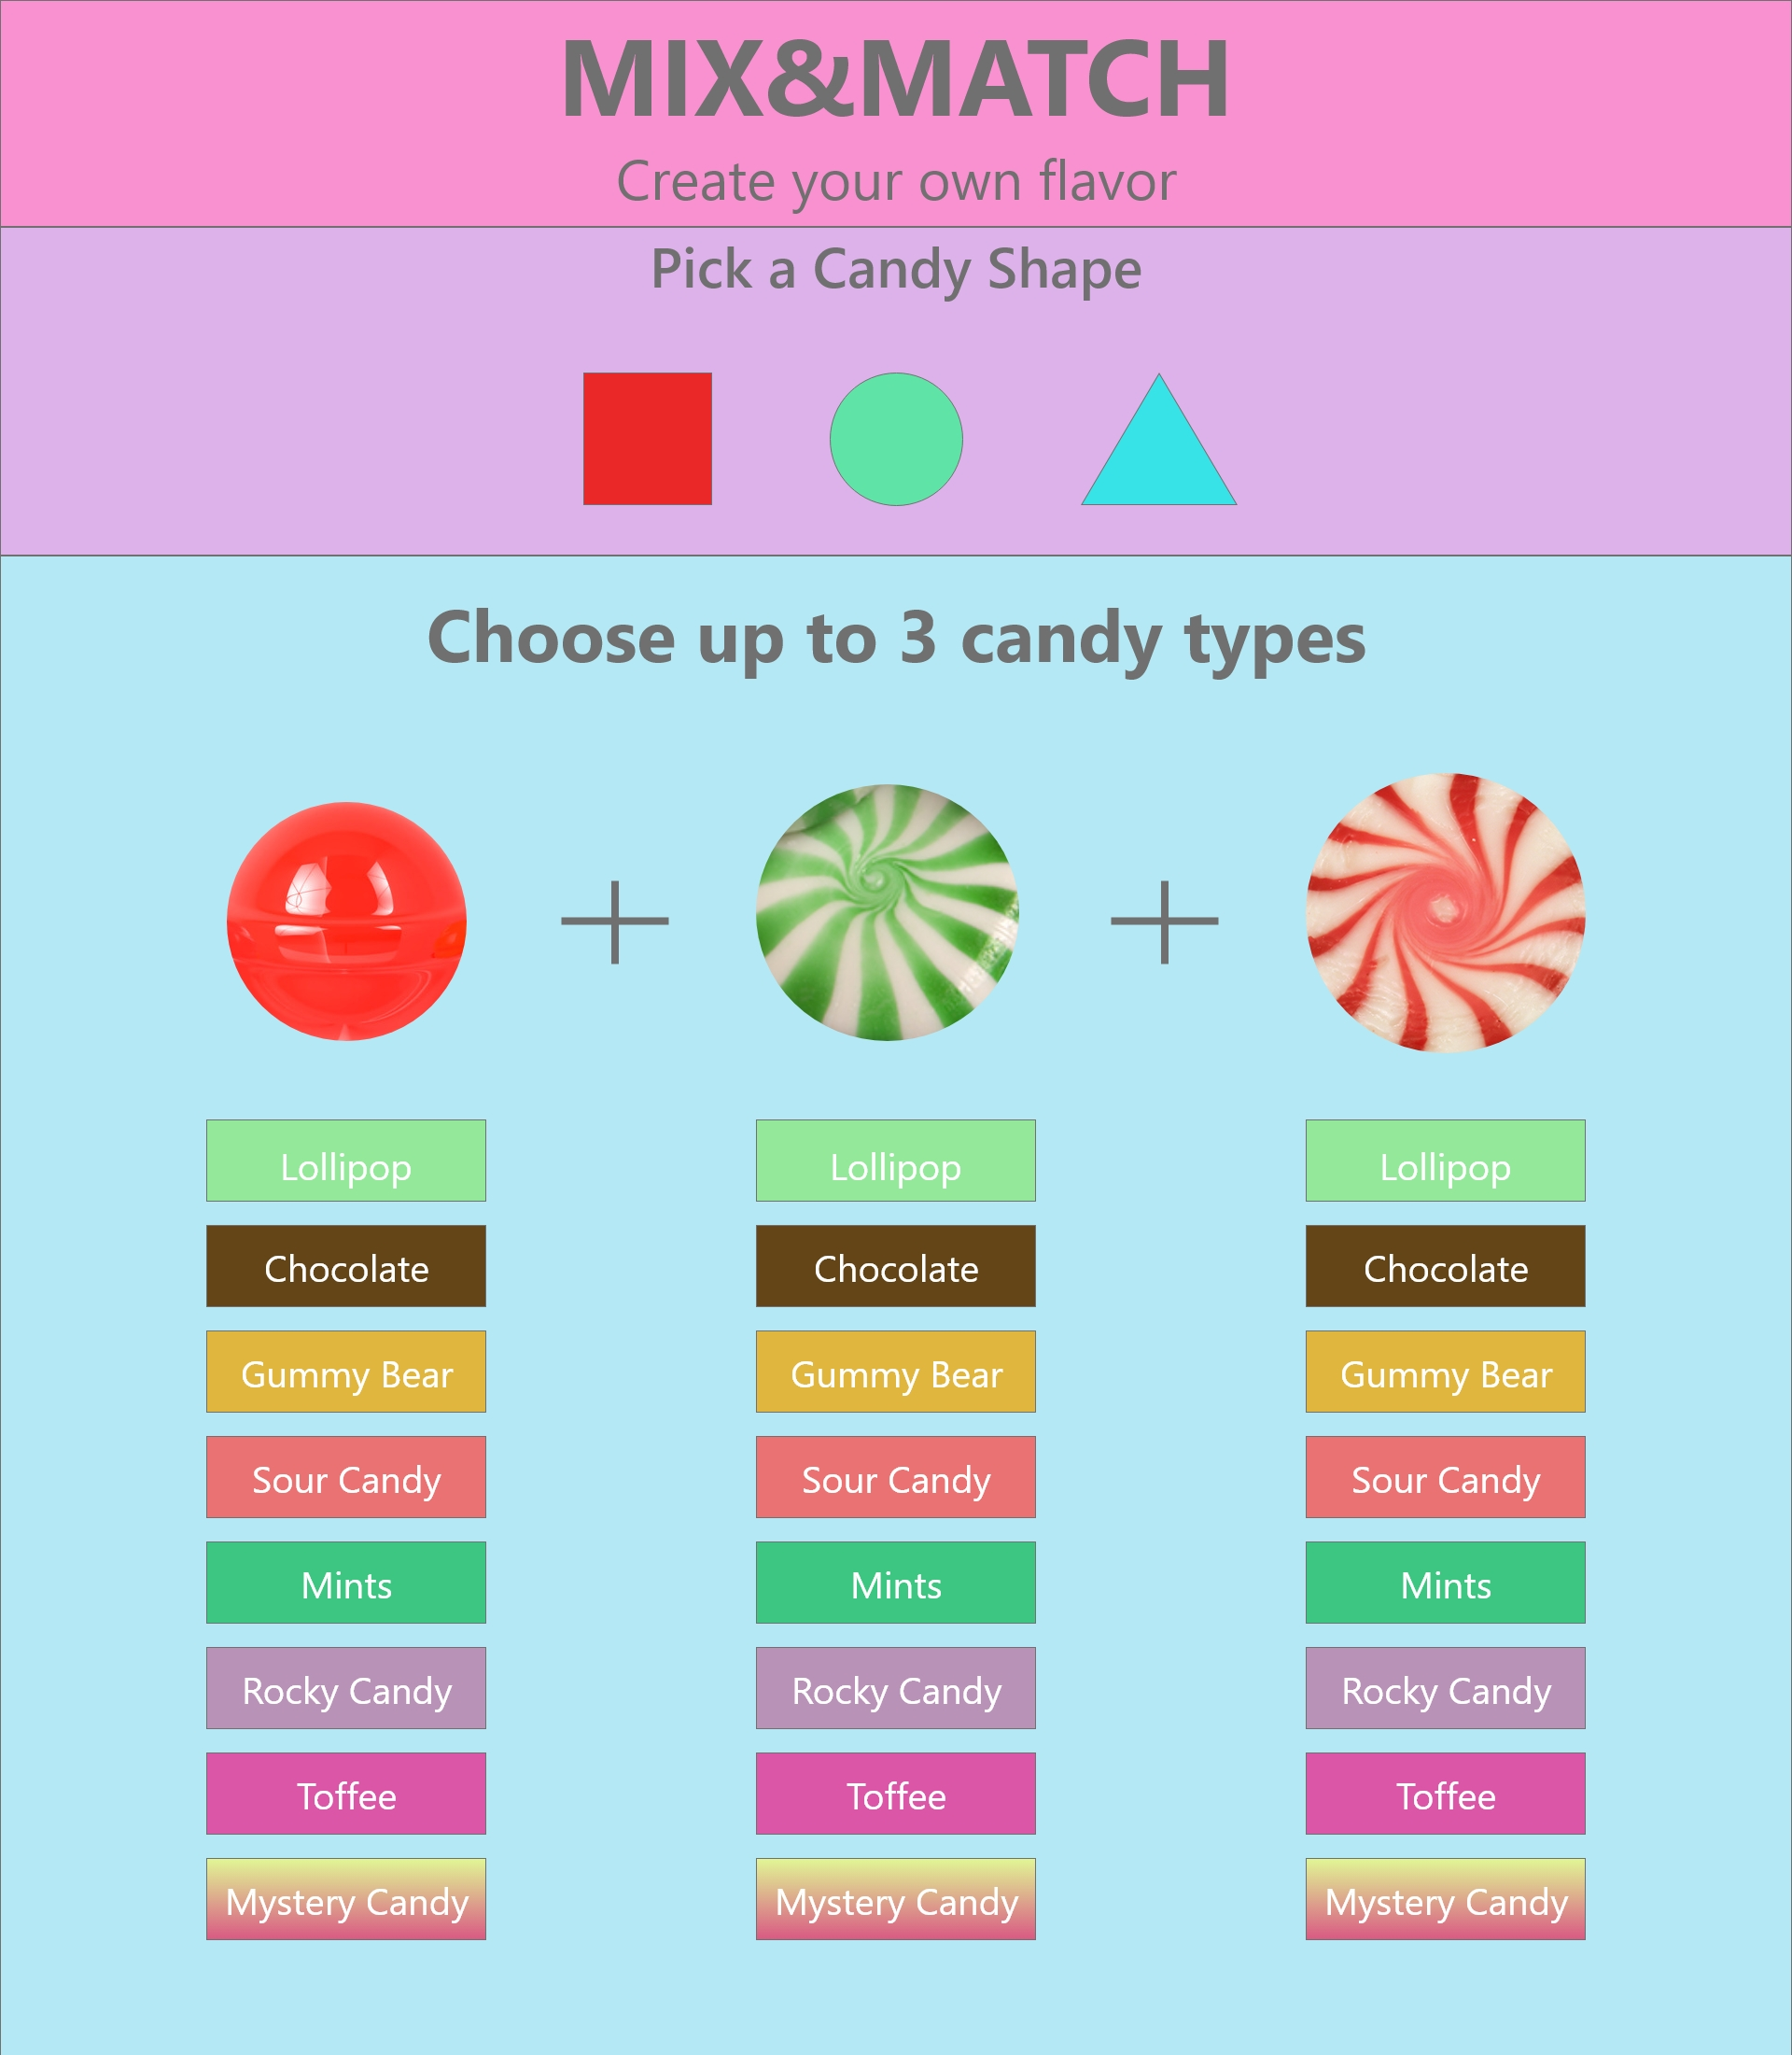
Mix & Match Layout

Slide 7
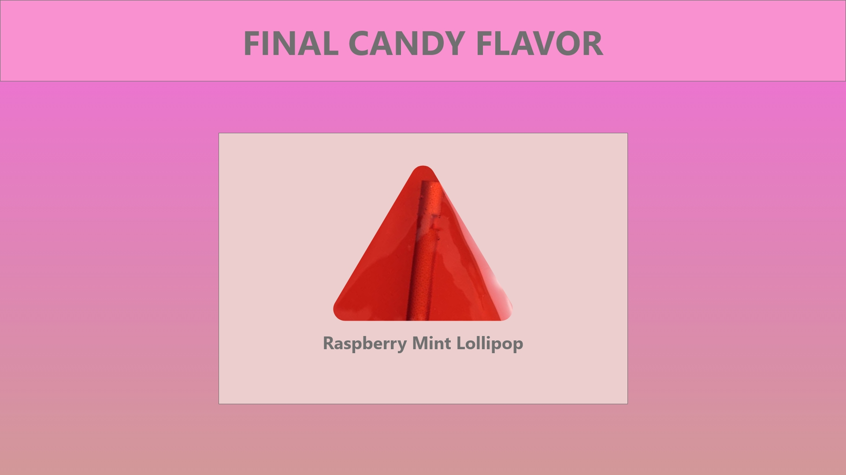
Mix &Match Result

Slide 8
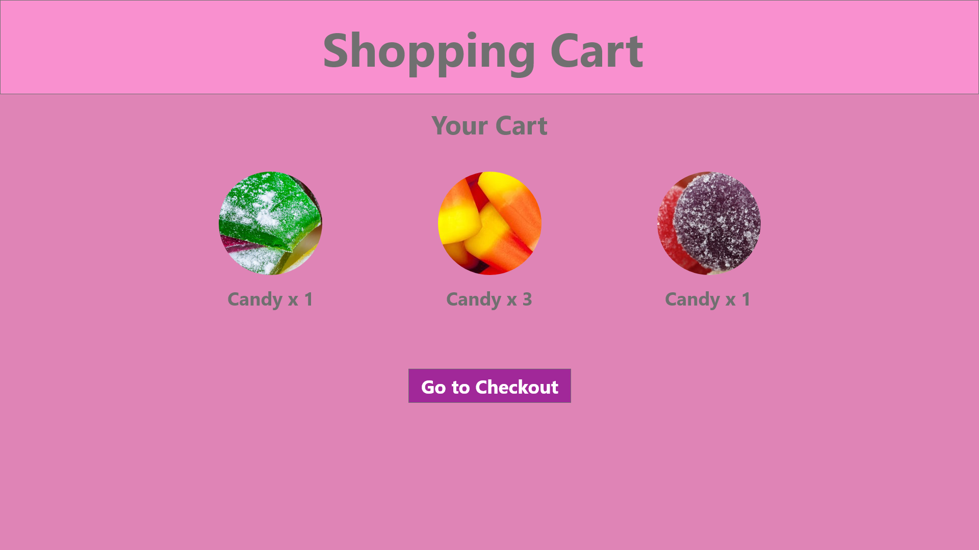
Shopping Cart

Slide 9
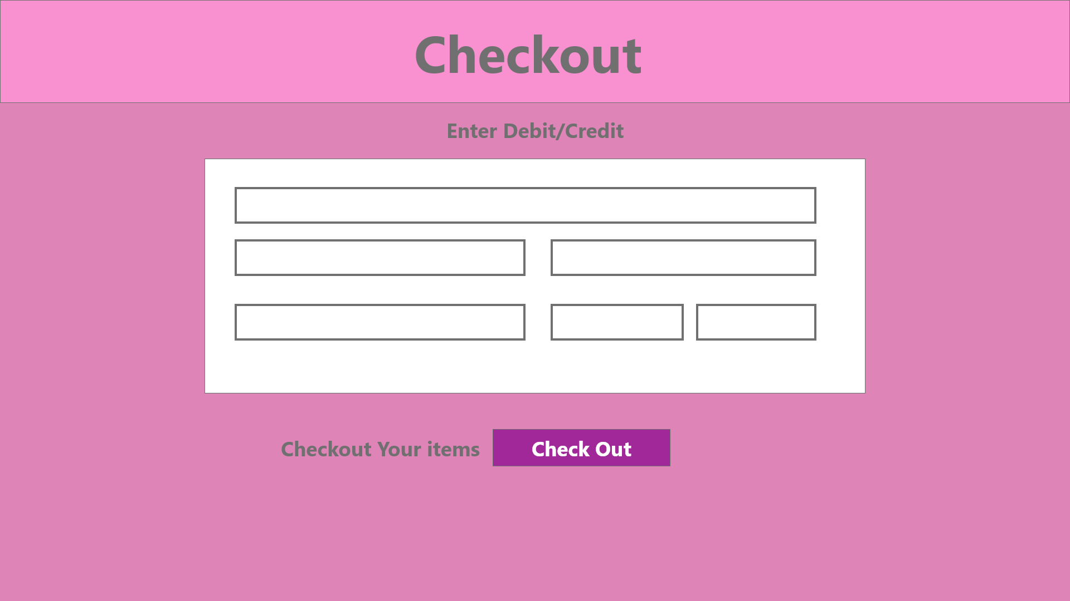
Checkout

